Slide 1



SMART BUS VARIFICATION SYSTEM
TEAM MEMBERS : DHANU SHREE (25ITR021)
ESAIMOZHI M (25ITR033)
HARINI P (25ITR041)
HARINI SREE (25ITR042)
INBARASI E (25ITR048)
COURSE | : | 24ITL34 – DESIGN THINKING LABORATORY
EXERCISE | : | 5 – CREATE USER PERSONAS FOR YOUR PRODUCT OR SERVICE 6-DEVELOP SCAMPER TEMPLATE FOR IDEATION 7- CREATE USER SCENARIO/STORY TELLING FOR YOUR PRODUCT OR SERVICE
DATE | : | 23/10/2026

Slide 2

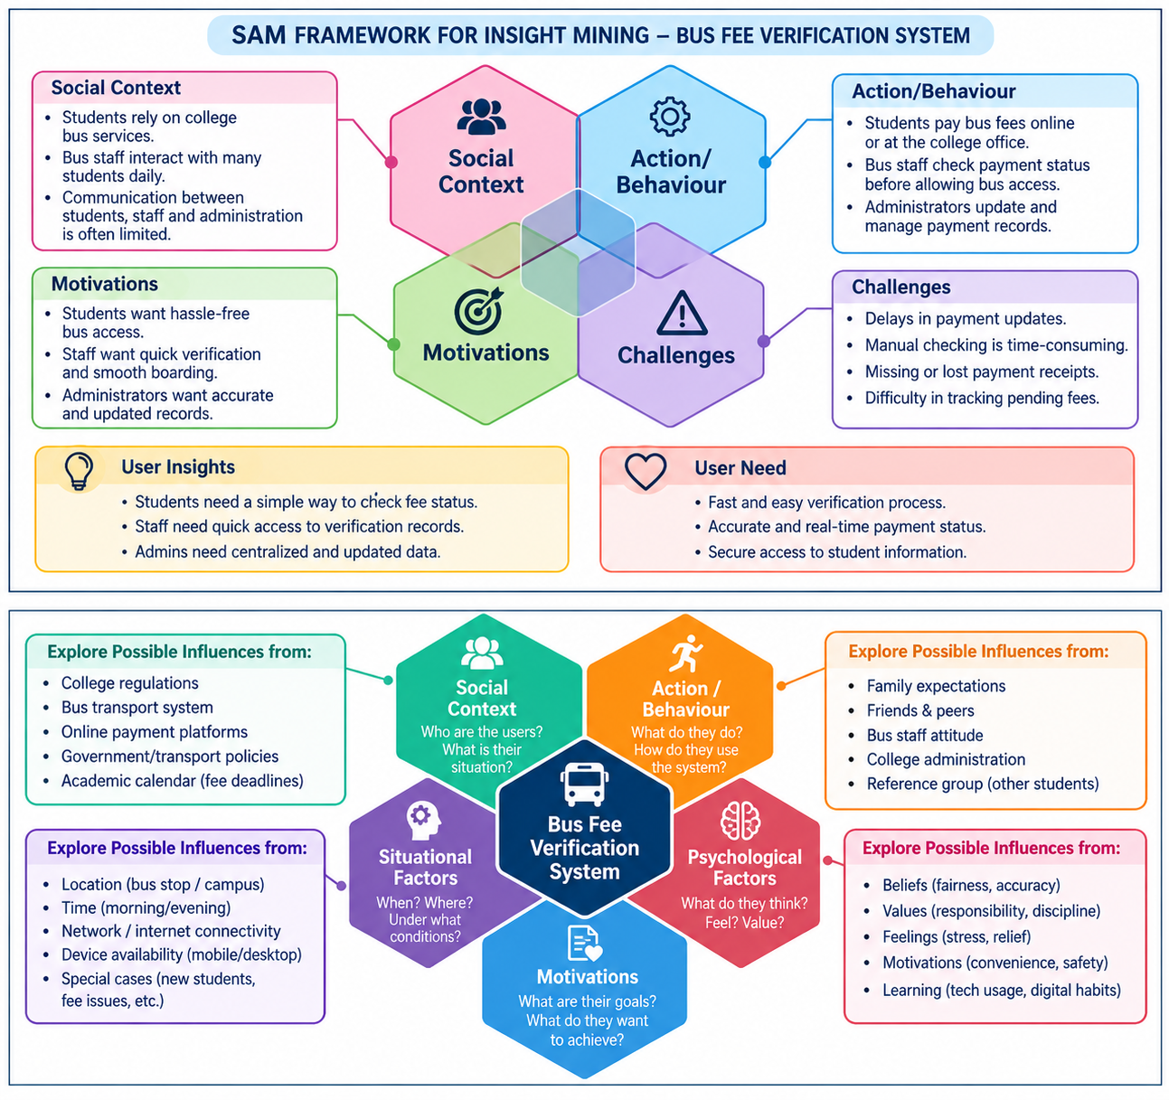
T25: SPICE Framework for Understanding & Uncovering Deep User Needs

Slide 3
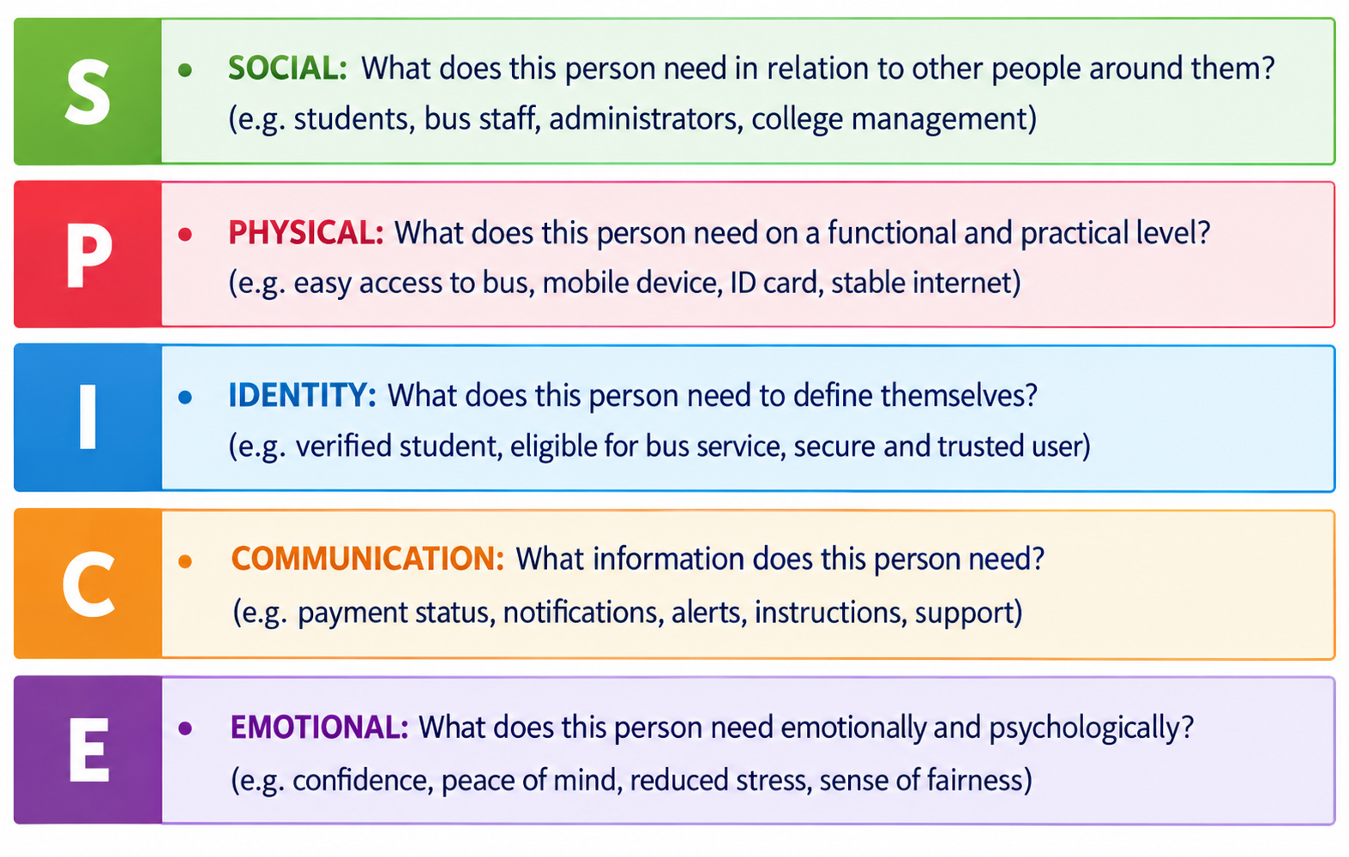
T25: SPICE Framework for Understanding & Uncovering Deep User Needs

Slide 4
T26: Sample Need Statments
  Students need a quick way to verify their bus fee payment because carrying and presenting receipts can be inconvenient.
Bus staff need an easy verification method because checking every student's receipt manually takes time.
College administrators need centralized payment records because managing paper records can lead to errors.
Students need clear payment status updates because they may be unsure whether their fees have been recorded.
College management needs reliable verification because it helps identify students with pending bus fees.

Slide 5
T27: Documenting Insights and Needs
User Insight | User Need
Manual verification takes time. | A faster digital verification method.
Students may lose receipts. | An alternative digital payment confirmation.
Payment records may not be updated immediately. | Accurate and updated fee information.
Staff find it difficult to check many students. | Quick verification using student ID or QR code.
Administrators manage many payment records. | A centralized system for maintaining records.

Slide 6
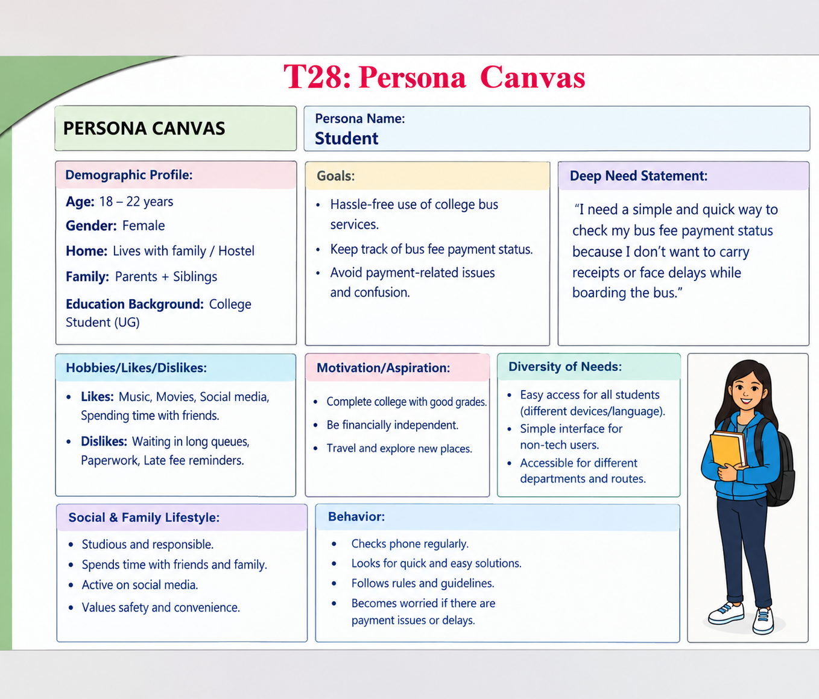
T28: Persona Canvas

Slide 7
T29: SCAMPER Worksheet
SCAMPER | Ideas for Our Project
S – Substitute | Substitute manual fee checking with digital verification.
C – Combine | Combine student ID, fee payment records, and QR code verification.
A – Adapt | Adapt QR-based scanning for checking bus fee status.
M – Modify | Make the verification process faster and easier using a digital system.
P – Put to another use | Use the system to generate fee payment reports for college administration.
E – Eliminate | Eliminate repeated manual checking and paper-based records.
R – Reverse / Rearrange | Verify the student's fee status before allowing bus access.

Slide 8
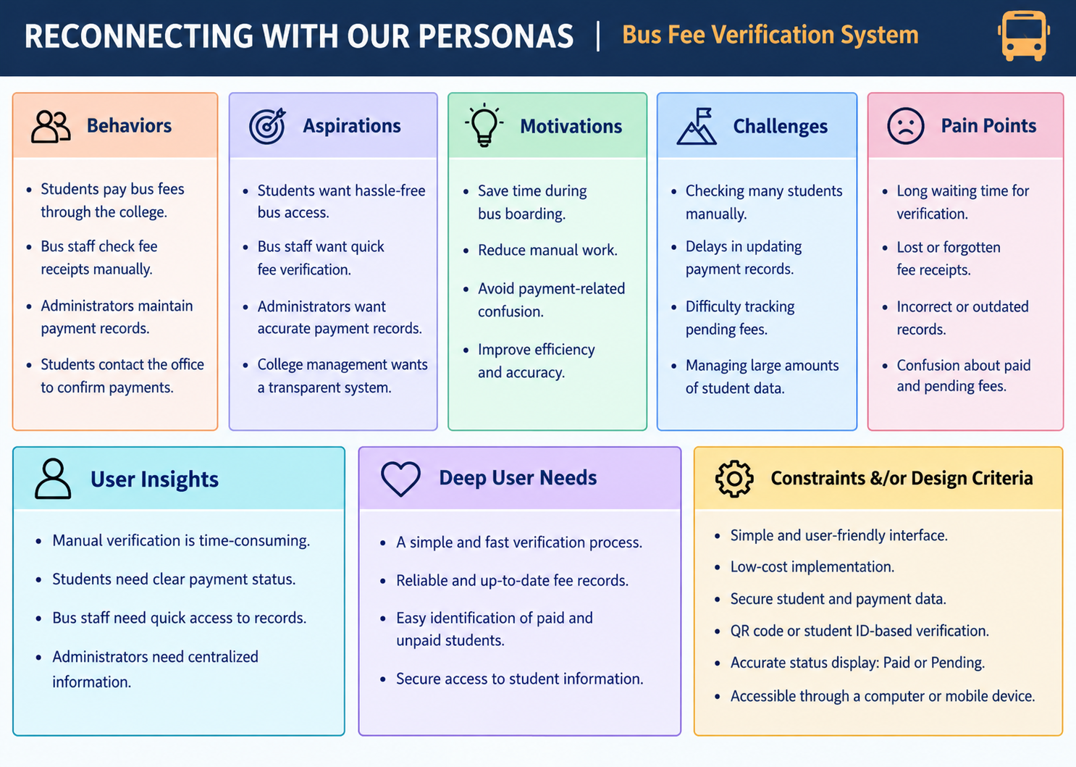
T30: Reconnecting Personas

Slide 9
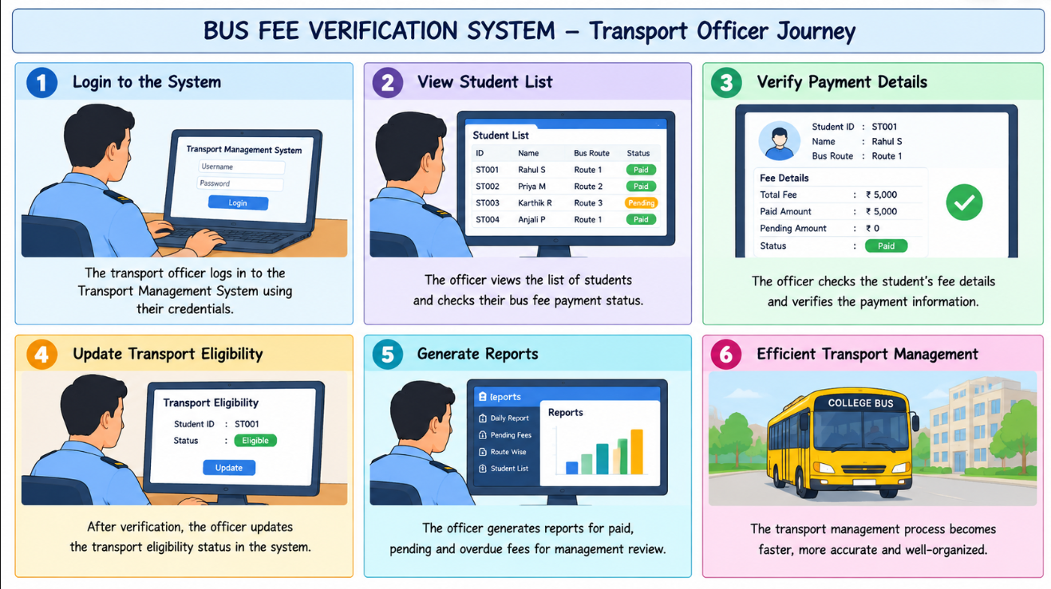
T31: Storyboard Canvas

Slide 10
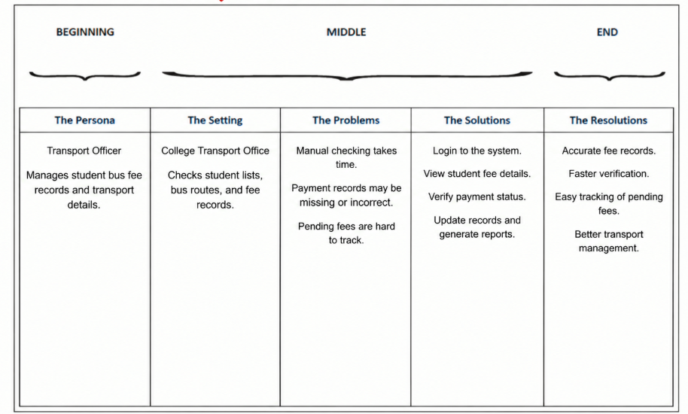
T32: Storyboard Canvas for Your Persona’s

